Slide 1
MUSIC GENRE CLASSIFICATION
APURVA, WEI-JEN

Slide 2
Project Goals

Slide 3
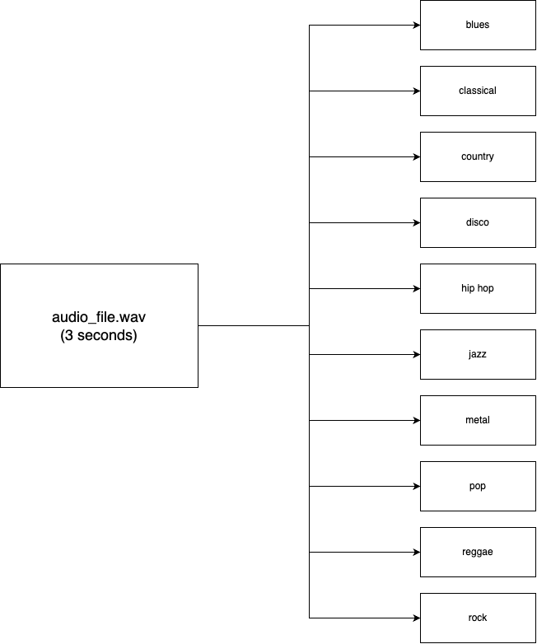
Music Genre Classification
Initially worked on classifying between metal and classical genre types
Moved onto 10 unique genres for classification
Audio files (.wav, .mp3) -> text classification

Slide 4














Measuring Success
Accuracy on tests within dataset
Accuracy of tests outside of dataset
Accuracy to music that has been released relatively recently

Slide 5
Exploring the Dataset

Slide 6
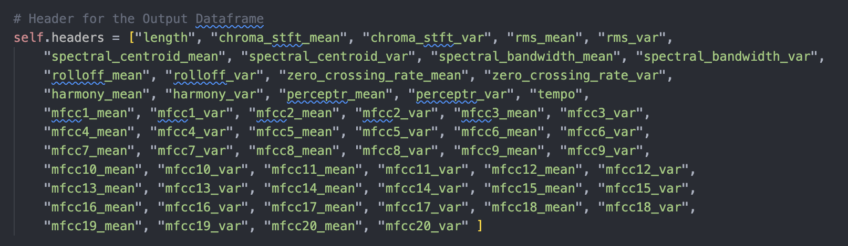
Features
Features can roughly be categorized into chroma features, spectral features, zero crossing rate, and Mel-frequency cepstral coefficients (MFCCs).

Slide 7
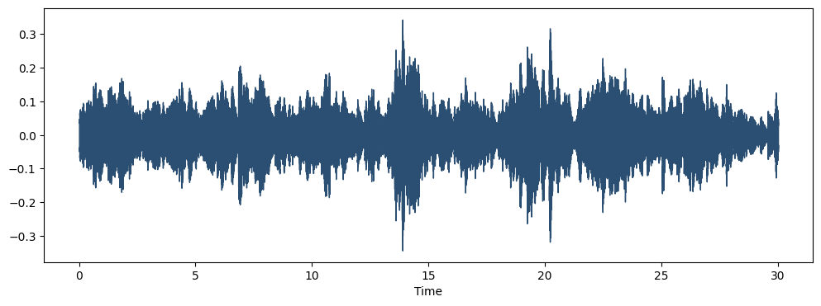
Waveform
Waveforms are visual representations of sound as time on the x-axis and amplitude on the y-axis.
Great for allowing us to quickly scan the audio data and visually compare and contrast which genres might be more similar than others.

Slide 8
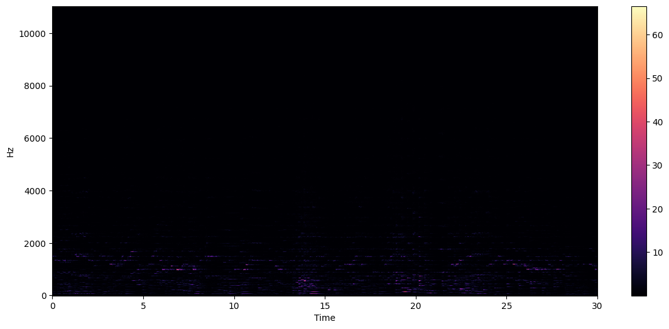
Spectogram
A spectrogram is a visual way of representing the signal loudness of a signal over time at various frequencies present in a particular waveform.

Slide 9
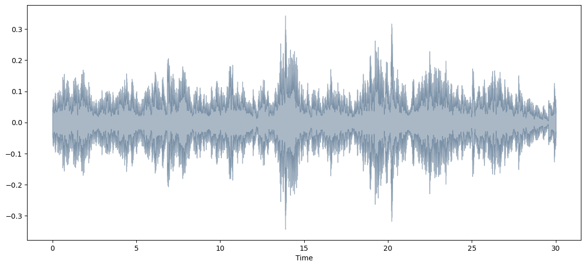
Spectral Rolloff
Spectral Rolloff is the frequency below which a specified percentage of the total spectral energy lies
librosa.feature.spectral_rolloff computes the rolloff frequency for each frame in a signal.

Slide 10
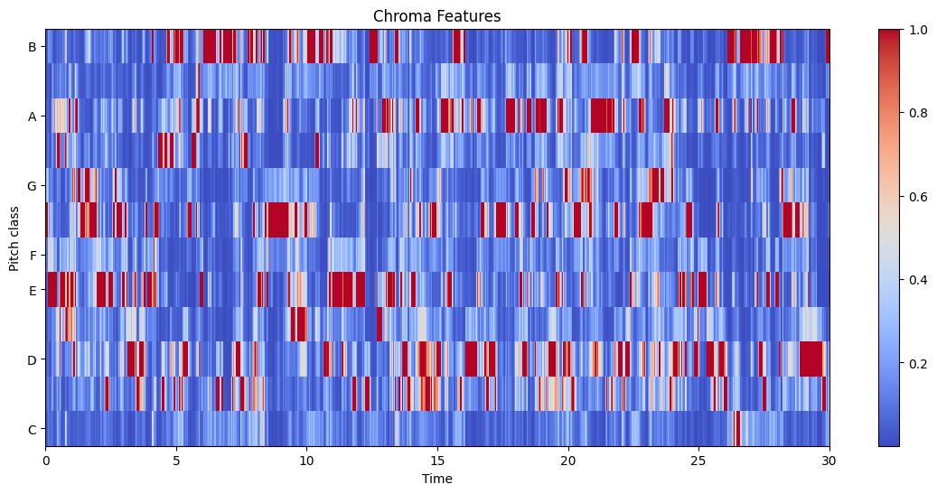
Chroma Feature
Powerful tool for analyzing music features whose pitches can be meaningfully categorized and whose tuning approximates to the equal-tempered scale
Capture harmonic and melodic characteristics of music while being robust to changes in timbre and instrumentation

Slide 11
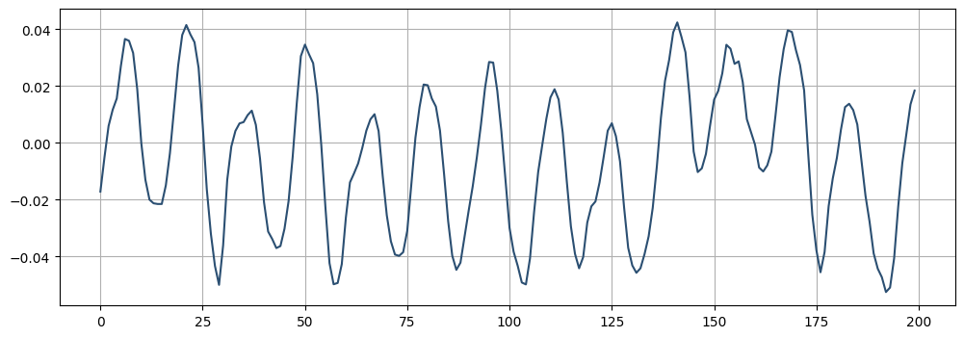
Zero Crossing Rate
The rate at which zero-crossings occur is a simple measure of the frequency content of a signal
Zero-crossing rate is a measure of the number of times in a given time interval/frame that the amplitude of the speech signals passes through a value of zero.

Slide 12
Building our Model

Slide 13
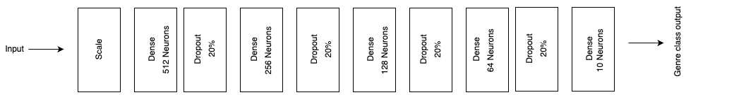
Tensorflow Keras/Sequential
Keras: high-level neural networks library from Tensorflow
Allows for customization of layers, activation functions, & training parameters
Sequential: the type of design our model will use, basically we designate the layers sequentially
https://www.tensorflow.org/api_docs/python/tf/keras/Sequential
Notes:
Training parameters include: epochs, batch size and more.

Slide 14
Dense Layers
Each neuron in a dense layer receives input from all units of the previous layer, (this is where the model learns the weights through backpropagation during training)
First Dense Layer: 512 neurons, ReLU activation.
Second Dense Layer: 256 neurons, ReLU activation.
Third Dense Layer: 128 neurons, ReLU activation.
Fourth Dense Layer: 64 neurons, ReLU activation.
Fifth Dense Layer: 10 neurons, softmax activation.
https://www.tensorflow.org/api_docs/python/tf/keras/Sequential
Notes:
Step 1: Linear Transformation (`dot(input, kernel) + bias`)
- Input: This is the data that the layer receives. For the first dense layer in a neural network, the input would be your feature data (e.g., various characteristics extracted from music files). For subsequent dense layers, the input is the output from the previous layer.
- Kernel: Also known as the weights matrix, this is a set of learnable parameters within the layer. Each neuron in the dense layer has its own set of weights, which are used to scale the input values in some way. The "dot" operation mentioned refers to the dot product between the input vector and this weights matrix. It's a mathematical way to combine the information from the inputs according to the importance (weights) the model currently assigns to those inputs.
- Bias: This is another set of learnable parameters, but unlike the kernel, which scales the input data, the bias allows the neuron to adjust the output independently of its input. Each neuron has one bias. Adding bias is like shifting the output curve up or down to better fit the data.
- The Linear Equation: `dot(input, kernel) + bias` is essentially a linear equation (like \(y = mx + c\) in basic algebra, where \(m\) and \(c\) correspond to the kernel and bias, respectively). It scales the input data and shifts it, creating a linear transformation of the input.
Step 2: Non-linear Transformation (`activation( ... )`)
- Activation Function: After the linear step, the result is passed through an activation function. This function is applied element-wise, meaning separately to each value resulting from the linear transformation. The purpose of the activation function is to introduce non-linearity into the output of the neuron. Real-world data is complex and non-linear, so to capture these complexities and learn from them, non-linearity is essential. Common activation functions include ReLU (Rectified Linear Unit), sigmoid, and softmax.

Slide 15
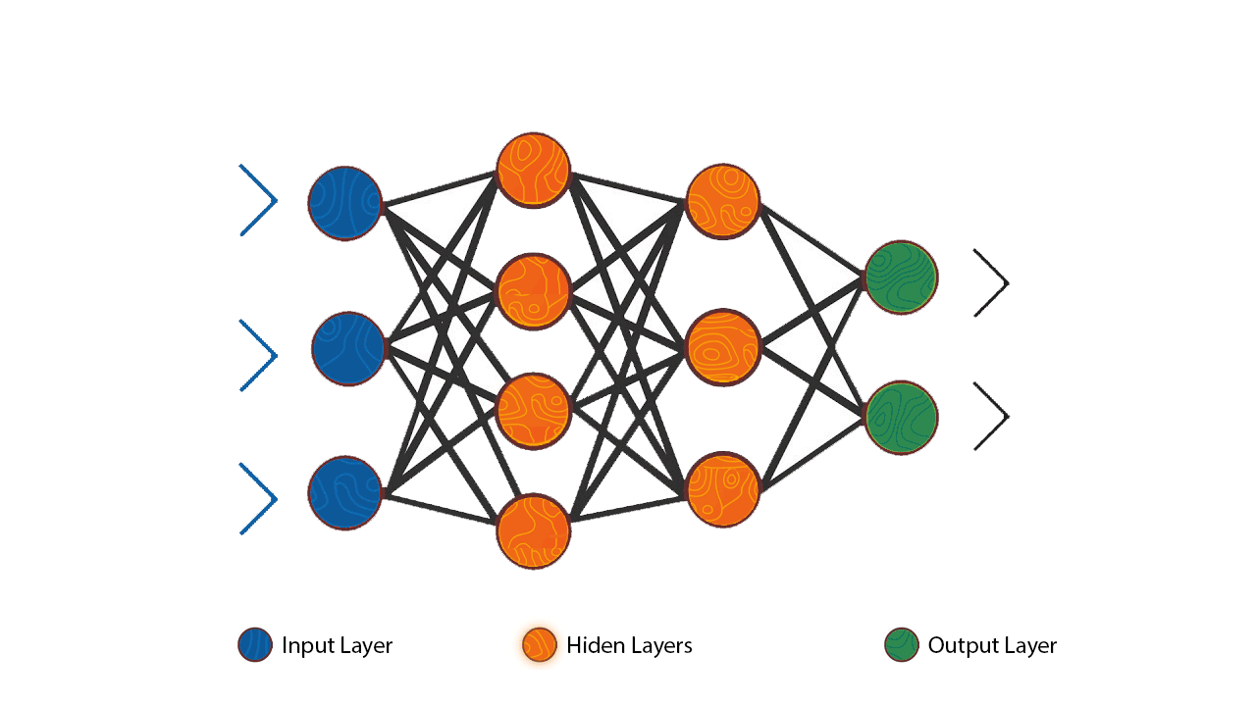
Dense Layers
Notes:
Representation Power: Dense layers can learn distinct representations of data, with successive layers refining these representations towards the prediction task, from basic patterns to complex features.
Learning Non-linear Relationships: Non-linear activation functions enable dense layers to capture complex, non-linear relationships in the data, crucial for tasks like music genre classification.
Flexibility: Dense layers are highly flexible and can be incorporated into various neural network architectures, accommodating diverse input-output mappings.
Simplicity and Efficiency: Despite their power, dense layers remain conceptually simple and computationally efficient, making them essential components across a wide range of neural network applications.

Slide 16
Step 1: Linear Transformation
Dot Product: calculate the dot product of the input data and the layer's weights (kernel)
Bias Addition: A bias term is added to the result (allows the layer to shift the activation values, introducing an additional degree of freedom for the network to learn)
https://www.tensorflow.org/api_docs/python/tf/keras/Sequential
Notes:
### Step 1: Linear Transformation (`dot(input, kernel) + bias`)
- **Input**: This is the data that the layer receives. For the first dense layer in a neural network, the input would be your feature data (e.g., various characteristics extracted from music files). For subsequent dense layers, the input is the output from the previous layer.
- **Kernel**: Also known as the weights matrix, this is a set of learnable parameters within the layer. Each neuron in the dense layer has its own set of weights, which are used to scale the input values in some way. The "dot" operation mentioned refers to the dot product between the input vector and this weights matrix. It's a mathematical way to combine the information from the inputs according to the importance (weights) the model currently assigns to those inputs.
- **Bias**: This is another set of learnable parameters, but unlike the kernel, which scales the input data, the bias allows the neuron to adjust the output independently of its input. Each neuron has one bias. Adding bias is like shifting the output curve up or down to better fit the data.
- **The Linear Equation**: `dot(input, kernel) + bias` is essentially a linear equation (like \(y = mx + c\) in basic algebra, where \(m\) and \(c\) correspond to the kernel and bias, respectively). It scales the input data and shifts it, creating a linear transformation of the input.

Slide 17
Step 2: ReLU Activation Function
ReLu is Rectified Linear Unit: f(x) = max(0, x)
Captures non-linear relationships and introduces them into the output of the neuron
Linear for all positive values of x, its output is 0 for all negative values of x
Sparse activation
https://www.tensorflow.org/api_docs/python/tf/keras/Sequential
Notes:
Activation Function: After the linear step, the result is passed through an activation function. This function is applied element-wise, meaning separately to each value resulting from the linear transformation. The purpose of the activation function is to introduce non-linearity into the output of the neuron. Real-world data is complex and non-linear, so to capture these complexities and learn from them, non-linearity is essential. Common activation functions include ReLU (Rectified Linear Unit), sigmoid, and softmax.
Dense layers are the basic building blocks of neural networks. They are responsible for performing linear transformations on the input data, followed by an activation function.
1. **Dot Product**: The first step is to calculate the dot product of the input data and the layer's weights (kernel). This is essentially a matrix multiplication operation, where each input feature is multiplied by a corresponding weight and then summed up.
2. **Bias Addition**: After the dot product, a bias term is added to the result. The bias allows the layer to shift the activation values, introducing an additional degree of freedom for the network to learn.
3. **Activation Function**: The final step is to apply an activation function to the result of the dot product and bias addition. The activation function introduces non-linearity to the network, allowing it to model complex relationships in the data.
The value added by dense layers is their ability to learn complex patterns and extract meaningful features from the input data. By stacking multiple dense layers, the network can progressively learn more abstract and higher-level representations of the data, which is essential for tasks like classification or regression.
Now, let's discuss the ReLU (Rectified Linear Unit) activation function and why it's a popular choice:
1. **Non-linearity**: ReLU introduces non-linearity to the network, which is crucial for modeling complex, non-linear relationships in the data. Without non-linearity, the network would be limited to learning only linear functions.
2. **Sparse Activation**: ReLU sets all negative values to zero, creating sparse activations. This sparsity can lead to better generalization and help prevent overfitting, as it encourages the network to learn more robust and efficient representations.
3. **Computational Efficiency**: ReLU is a simple and computationally efficient function, as it involves a straightforward thresholding operation. This efficiency is particularly valuable when working with large neural networks or training on resource-constrained devices.
4. **Gradient Propagation**: ReLU partially addresses the vanishing gradient problem, which can occur during training of deep neural networks. Unlike sigmoid or tanh activation functions, the gradient of the ReLU function is either 1 or 0, which helps prevent the gradients from becoming too small or vanishing entirely.
While ReLU is a popular choice, it's not the only activation function used in neural networks. Other activation functions, such as leaky ReLU, ELU (Exponential Linear Unit), or variants like SELU (Scaled ELU), can also be used depending on the specific requirements of the task or the characteristics of the data.
In summary, dense layers perform linear transformations on the input data, and the ReLU activation function introduces non-linearity, sparsity, and computational efficiency, making it a widely adopted choice for many deep learning tasks, including your music genre classification project.

Slide 18
Dropout Layers
Used to reduce overfitting by randomly setting a fraction of input units to 0 at each update during training time
Our dropout rate is 20% for each dropout layer
Basically allows for the neural network to become more robust that doesn’t depend any single neuron
https://www.tensorflow.org/api_docs/python/tf/keras/Sequential
Notes:
Dropout layers randomly "turn off" or ignore some of the connections between the layers in the neural network during training. This means that the network can't rely on the same connections every time, and it has to learn to solve the problem using different combinations of connections.
By doing this, the neural network becomes more robust and doesn't depend too much on any single connection or feature. It also helps to prevent the network from memorizing the training data too well, which can lead to overfitting (like your friends simply memorizing the answers instead of actually understanding the math).

Slide 19
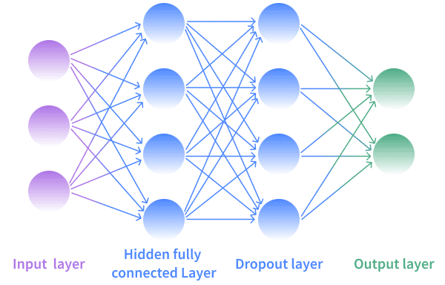
Dropout Layer

Slide 20
Output Layer
The final layer is another Dense layer with 10 neurons because we have 10 genres to classify and uses the softmax activation function.
Softmax is used for multi-class classification, and it outputs the probabilities of each class, with the sum of probabilities being 1
https://www.tensorflow.org/api_docs/python/tf/keras/Sequential
Notes:
The output layer is the final layer of the neural network, and it's responsible for producing the predicted output or classification. In your case, since you're dealing with a multi-class classification problem (classifying music into 10 different genres), the output layer has 10 nodes, one for each genre.
The role of the output layer is to take the output from the previous layer and transform it into a set of values that can be interpreted as probabilities for each class. This is where the softmax activation function comes into play. The softmax activation function is commonly used in multi-class classification problems, as it ensures that the outputs from the output layer sum up to 1, allowing them to be interpreted as probabilities.
In your music genre classification problem, the output from the softmax function represents the predicted probability distribution over the 10 genres. During training, the model learns to adjust the weights and biases in the network to produce output values that, when passed through the softmax function, result in high probabilities for the correct genre and low probabilities for the incorrect genres.

Slide 21
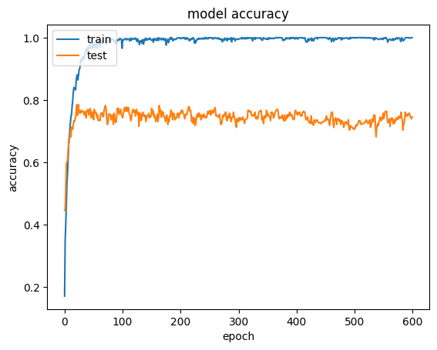
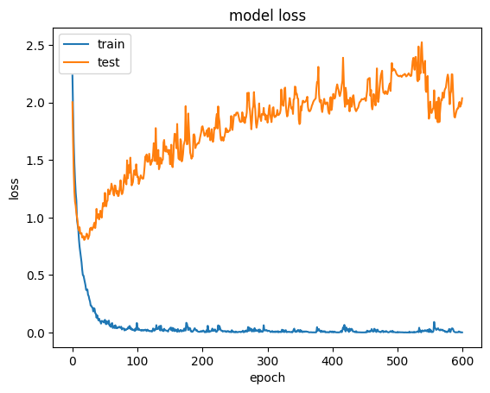
Model Metrics: 30 Second Model

Slide 22
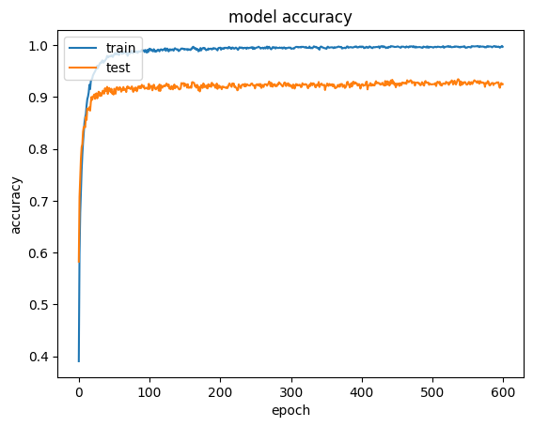
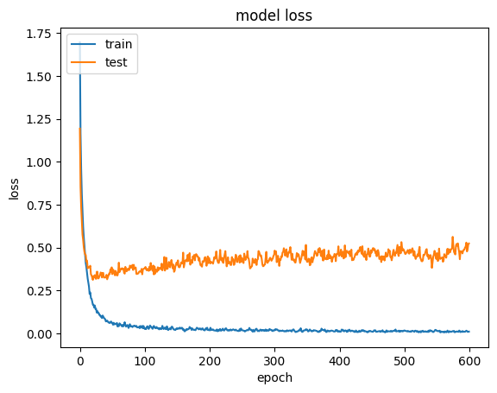
Model Metrics: 3 Second Model

Slide 23
Demonstration

Slide 24
Testing our Model

Slide 25
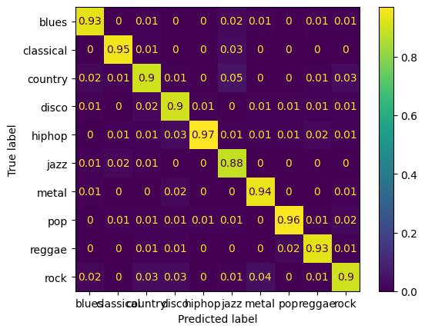
Confusion Matrix: 3 Seconds

Slide 26
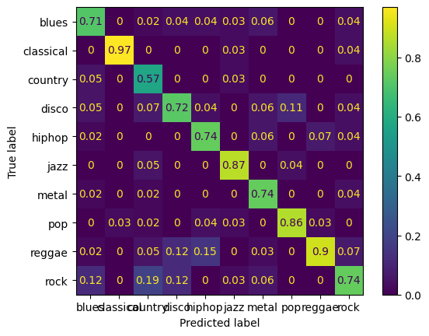
Confusion Matrix: 30 Seconds

Slide 27
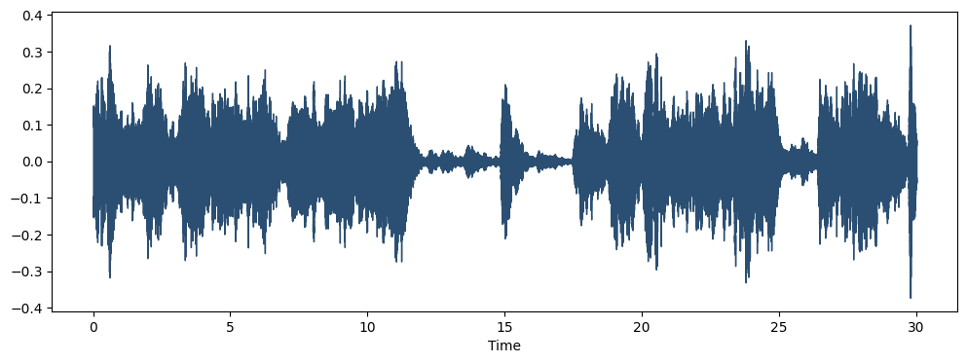
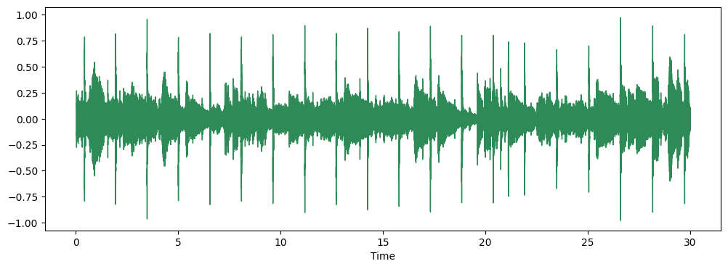
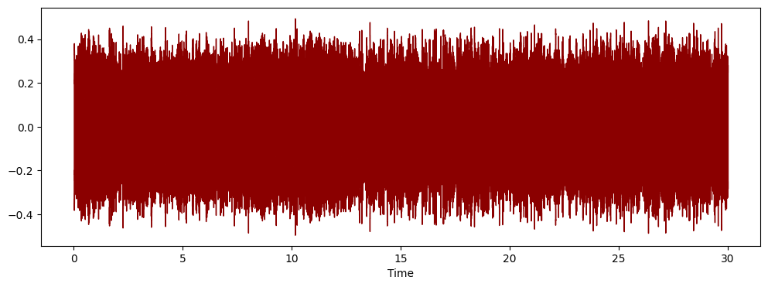
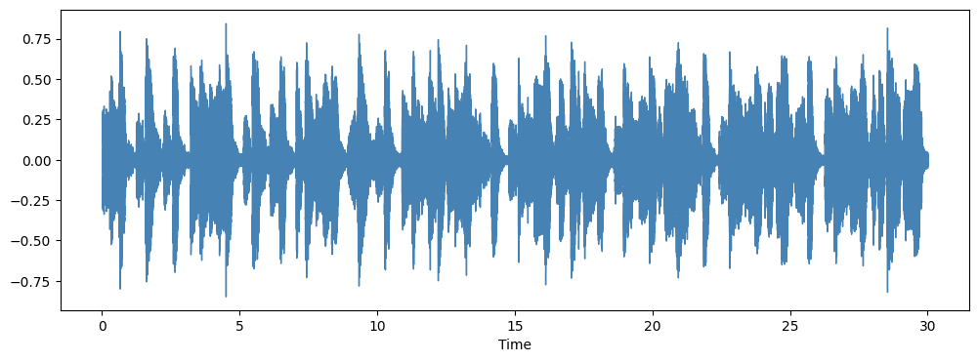
Waveforms of Different Genres
Classical
Reggae
Metal
Blues

Slide 28
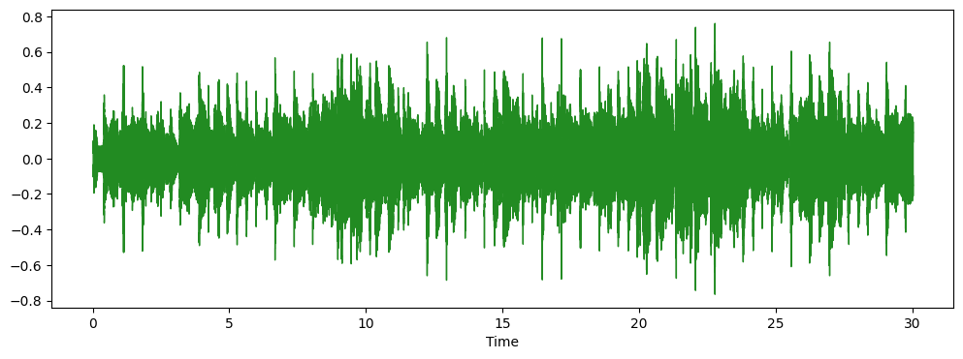
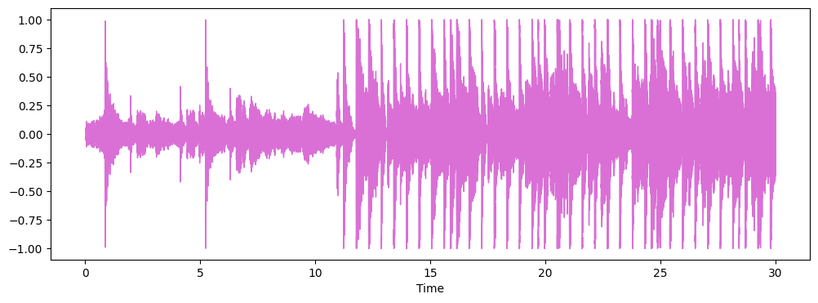
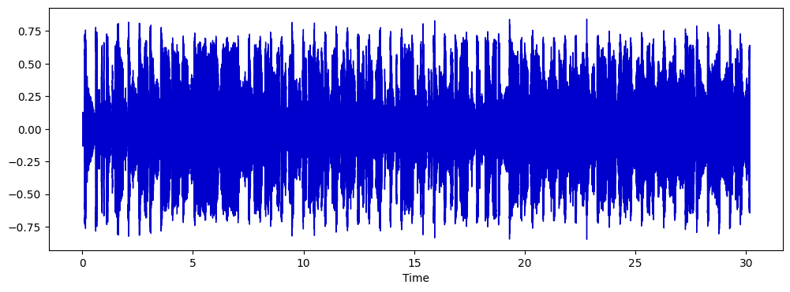
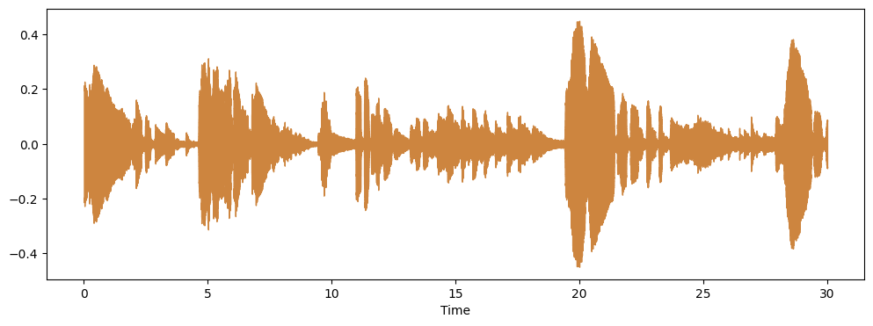
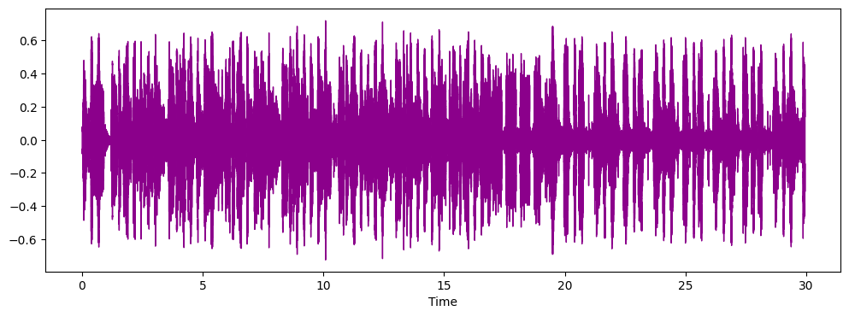
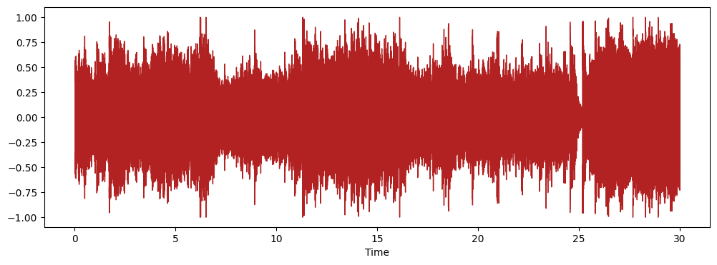
Country
Pop
Disco
Jazz
Hiphop
Rock

Slide 29
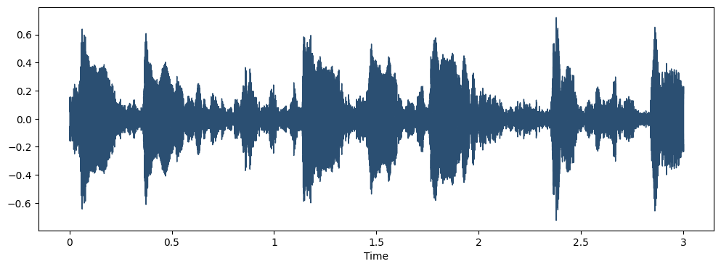
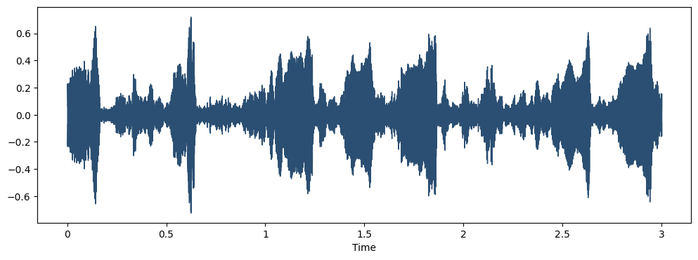
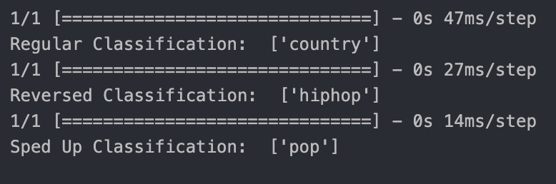
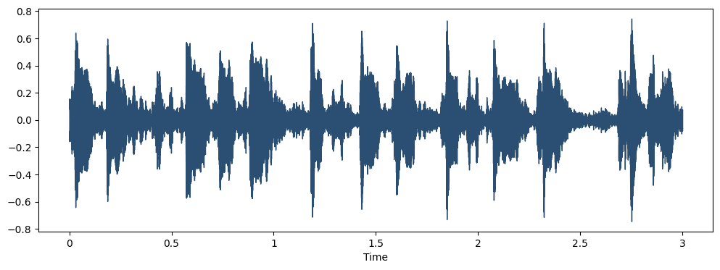
Case Study: Rap Freestyle
Large difference in waveform
Largest differences in MFCC values (1-20)
Without production, there is a lot of variability in the features

Slide 30
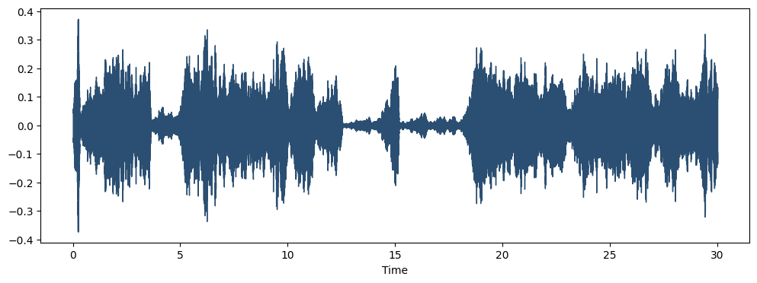

Slide 31
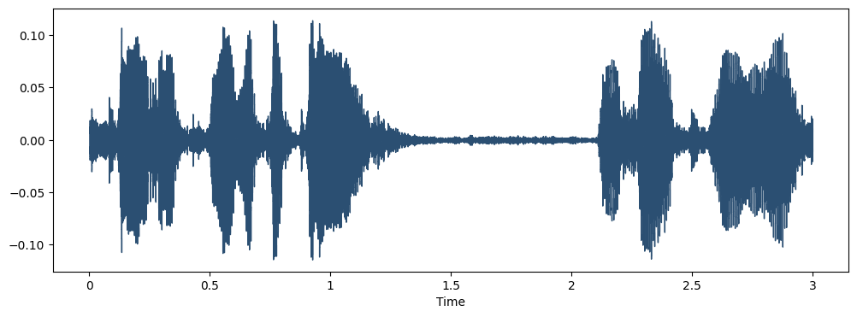
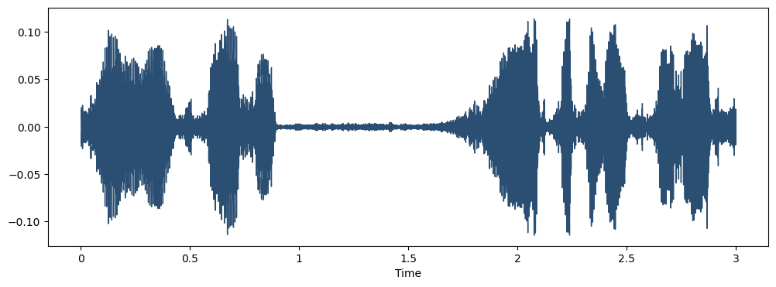
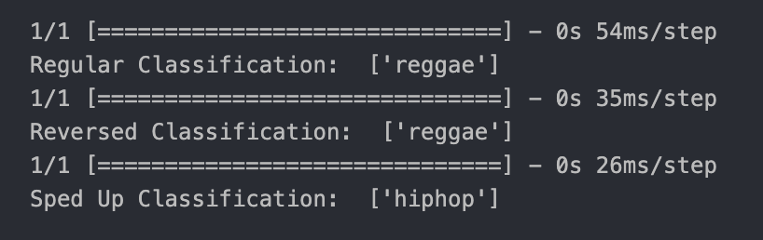
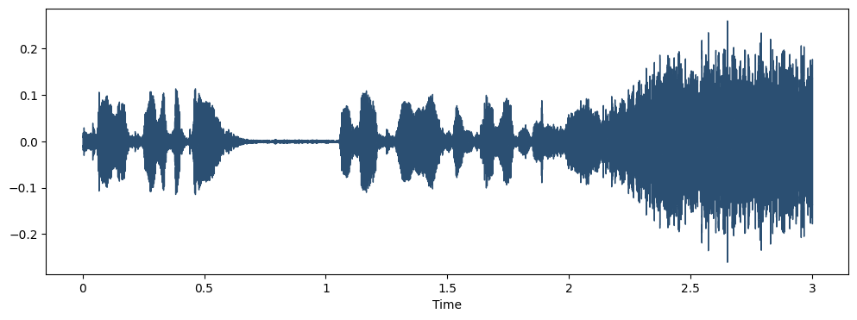
Case Study: State of Union
Very little waveform difference between normal, reversed
Largest differences in waveform for sped up production

Slide 32
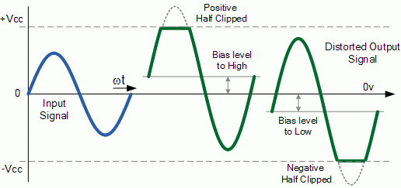
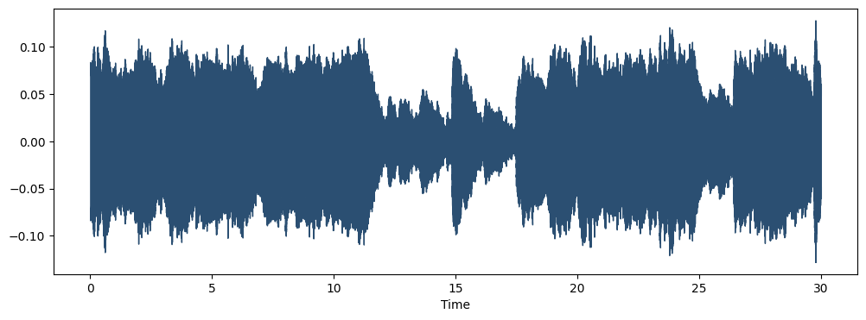

Distortion
Distortion occurs when an audio signal is clipped or truncated
Parts with smaller amplitudes are also amplified
Making the audio files more “rock” like

Slide 33
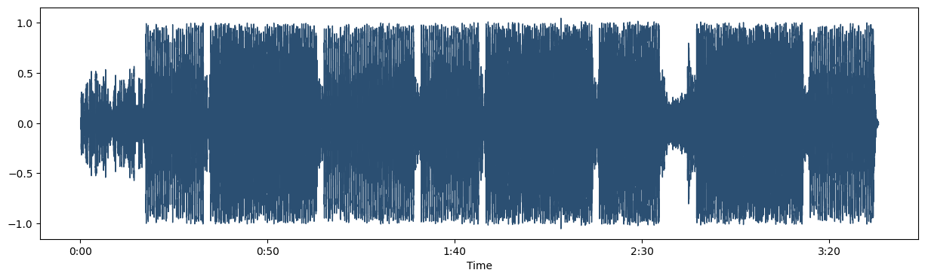
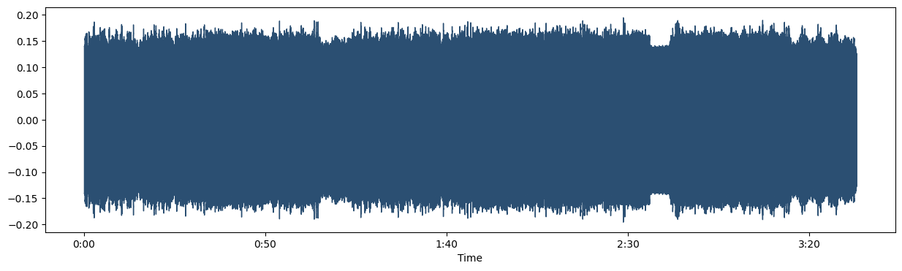
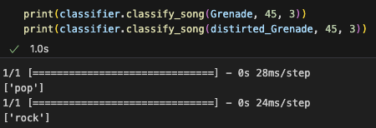
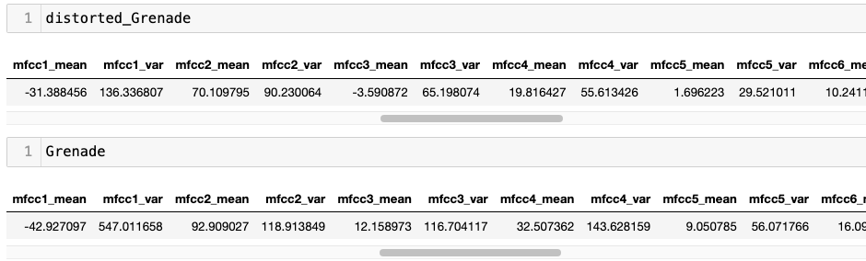
Misclassification: Distortion
Dynamic range of the waveform is reduced
The values of the features are also altered. Notably, most of the variances are decreased.

Slide 34
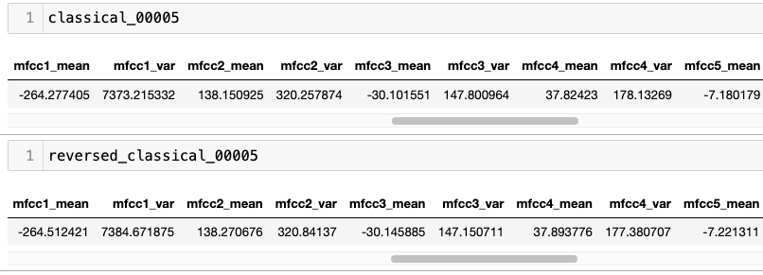
Reversal: Classical
When an audio file is reversed, the waveform is flipped along the y-axis
The characteristics of the initial waveform are preserved
The values of the features are similar between the reversed and the original

Slide 35
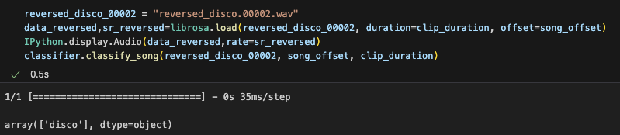
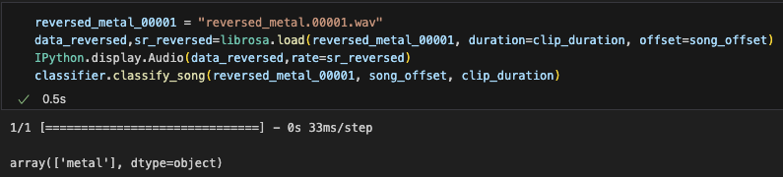
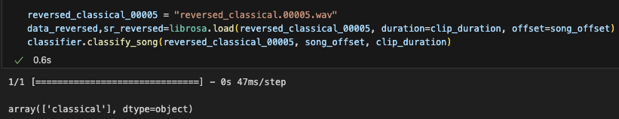

Slide 36
Comparing to Linear Associator

Slide 37
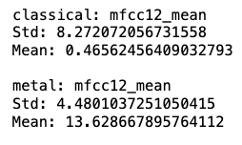
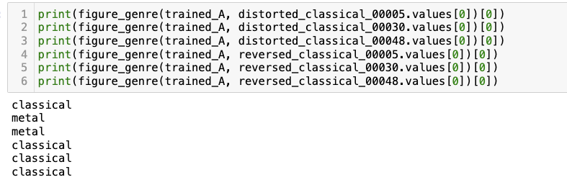
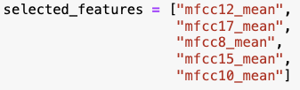
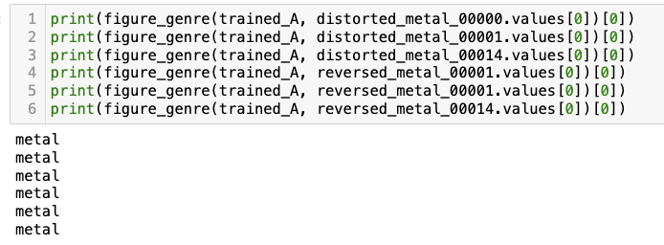
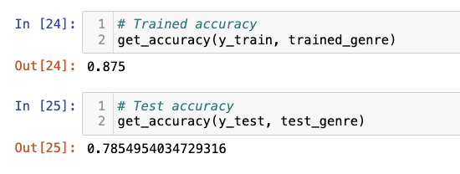
Feature Selection and Results
Examine means and standard deviations to select distinct features
Trained with 40 samples
Train accuracy: 79%
Test Accuracy: 78%
Distorted classical audio files are prone to misclassification

Slide 38
Concluding Remarks

Slide 39
Concluding Remarks
Genre classification is a very subjective measure, causing difficulty in classification
Generalizing classification based on entire song can be measured by taking the aggregate classifications, and finding the genre that is repeated the most throughout the song
Would be interesting to see how a CNN would perform on the graphical representations of features, rather than numeric representations

